Slide 1


Finding Top-k Shortest Paths with Diversity
TKDE 2018
Huiping Liu ¹, Cheqing Jin ¹, Bin Yang ², and Aoying Zhou ¹
1 East China Normal University, Shanghai, China
2 Aalborg University, Aalborg, Denmark

Slide 2
Outline
Motivation
Related work
Our solution
Conclusion

Slide 3
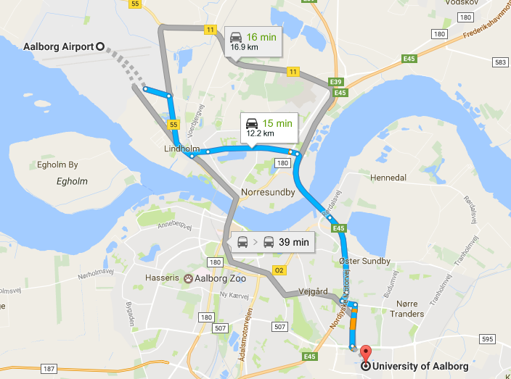
Motivation
10
B
1
C
A
1
10
1
D
3
18
20
F
I
1
1
The shortest path problem has been studied for several decades.
Wide applications, such as route planning.
The top-k shortest paths generally quite similar due to a large number of shared edges among them. Give more choices for users.
H
E
1
15
The shortest path from A to D is: A->B->C->D
The top-3 paths from Aalborg Airport to Aalborg University
---by Google maps
Notes:
添加一个多个最短路径的图例

Slide 4
K-Shortest Paths
10
B
1
C
A
1
10
1
D
3
18
Shortest path P1 (21)
20
F
I
1
1
H
E
B
1
1
15
10
C
A
1
10
1
D
B
1
3
18
10
C
20
F
A
1
10
I
1
1
1
D
E
2nd shortest path P2 (28)
3
18
H
20
F
1
15
I
1
1
H
E
4th shortest path P4 (30)
1
15
3rd shortest path P3: 29
10
B
1
B
1
C
10
C
A
1
10
A
10
1
D
1
1
D
3
18
3
18
20
F
20
F
I
1
1
I
1
1
E
E
1
H
H
15
1
15

Slide 5
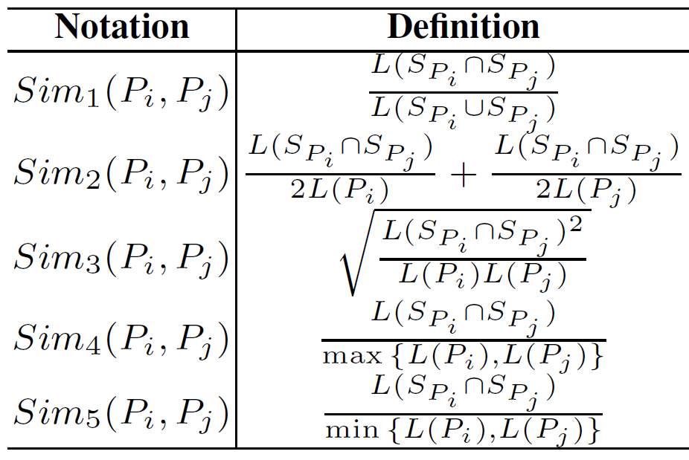
Path diversity
10
B
1
C
A
1
1
10
18
D
20
3
F
P1
I
1
1
H
E
1
15
Some paths can be highly similar due to commonly shared road segments.
Better to return paths with diversity.
Lots of Path Similarity definitions:
10
B
1
C
A
1
1
10
P2
18
D
20
3
F
I
1
1
H
E
1
15
The legnth of common segments shared by Pi and Pj
1
10
B
C
A
1
1
10
The length of distinct road segments shared by Pi and Pj
18
D
Sim. | P1 | P2 | P3 | P4
P1 | - | 0.26 | 0.25 | 0.28
P2 | - | - | 0.84 | 0.23
P3 | - | - | - | 0.23
P4 | - | - |  | -
P3
20
3
F
I
1
1
H
E
1
15
10
B
1
C
P4
A
1
1
10
18
D
20
3
F
I
1
1
Since P2 and P3 are high similar, it is better to return (P1, P2, P4) than (P1, P2, P3)
H
E
1
15

Slide 6

Problem definition
Sim. | P1 | P2 | P3 | P4
P1 | - | 0.26 | 0.25 | 0.28
P2 | - | - | 0.84 | 0.23
P3 | - | - | - | 0.23
P4 | - | - |  | -
Dissimilar path set Ψ contains several paths from s to t, such that for any two paths in Ψ, Pi and Pj, sim(Pi, Pj) < τ.
i.e, assuming τ=0.5, {P1, P2, P4} is a disimilar path set, but {P1, P2, P3} is not.
KSPD problem: Given parameter k, to find a dissimilar path set Ψ, such that |Ψ| ≤ k , and there does not exist another dissimilar path set Ψ’ with |Ψ’| ≤ k such that:
i.e, when k=3, τ=0.5, Ψ={P1, P2, P4} is the query result, because the length of all paths in Ψ is 79. While the length of all paths in {P1, P3, P4} is 80.

Slide 7
Related work
Top-k shortest simple paths
Yen’s algorithm and its variants
J. Y. Yen. Finding the k shortest loopless paths in a network. Management Science, 17(11):712–716, 1971.
L. Chang, X. Lin, L. Qin, J. X. Yu, and J. Pei. Efficiently computing top-k shortest path join. In Proc. EDBT, pages 133–144, 2015.
Too many shortest paths to compute KSPD
Diversified top-k query
div-cut
L. Qin, J. X. Yu, and L. Chang. Diversifying top-k results. PVLDB, 5(11):1124–1135, 2012.
Some optimization techniques cannot suit KSPD
Notes:
添加相关工作

Slide 8
Our Solution
KSPD problem is NP-hard
We propose a greedy algorithm to solve this problem:
First, we add the shortest path into the result set
Next, we greedily pick the next shortest path and insert it into the result set if the path is qualified
Finally, the process stops when the result set has already k diversified paths or all paths have been examined

Slide 9
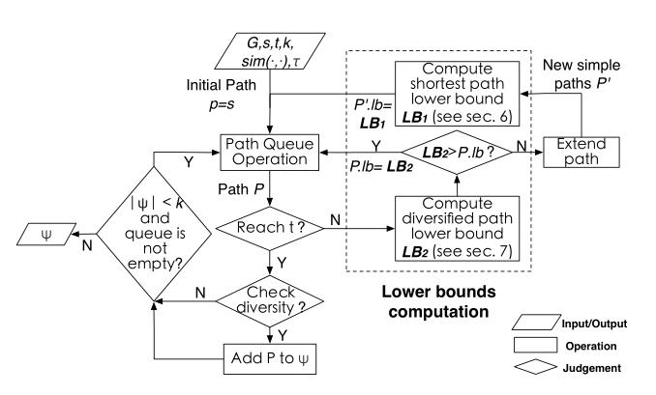
Framework
A best-first paradigm
Each time we get the path P with the minimal lower bound in the queue to explore
Two lower bounds to improve the efficiency
Shortest path lower bound to find the shortest paths efficiently
Diversified path lower bound to find the diversified paths efficiently
when diversity is not required or τ=1, our framework can also support KSP problem

Slide 10
Tech. 1: Shortest path lower bound
Reverse Shortest Path Tree
A reverse shortest path tree contains all vertex, and the edge from each vertice to the target vertice.
The cost to build such a tree is the same to run Dijkstra's Algorithm once.
B
1
10
B(11)
1
10
C
C(10)
A
10
A(21)
10
1
1
1
D(0)
18
D
3
F
F(14)
20
1
I(12)
1
1
I
1
E(1)
H
E
1
H(13)
1
15

Slide 11
Shortest path lower bound
Shortest path tree
We compute the shortest path lower bound of a partially explored path by using reverse shortest path tree
A full reverse shortest path tree that from a vertex to all other vertices in the graph is not necessary, we build a partial reverse shortest path tree and incrementally update it when a vertex’s shortest path lower bound is demanded.
B
1
10
B(11)
1
10
C
C(10)
A
10
A(21)
10
1
1
1
D(0)
18
D
3
F
F(14)
20
1
I(12)
1
1
I
1
E(1)
H
E
1
H(13)
1
15

Slide 12
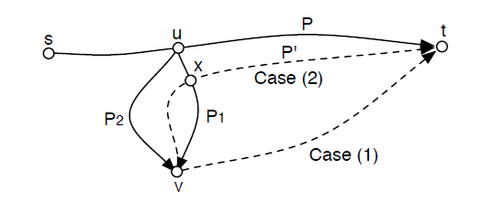
Shortest path lower bound
Pruning rule 1
a path may not need to be extended even its lower bound is minimal
for any two simple partially explored paths P1(s,v) and P2(s,v) that deviate from a common shortest path at the same vertex. Let P1(s,t), P2(s,t) be the shortest simple paths from s to t beginning with P1(s,v) and P2(s,v) respectively. If L(P1(s,v)) < L(P2(s,v)), then L(P1(s,t)) < L(P2(s,t))
there is no need to extend P2(s,v) at v before P1(s,t) is found

Slide 13
Shortest path lower bound
Pruning rule 1
for any two simple partially explored paths P1(s,v) and P2(s,v) that deviate from a common shortest path at the same vertex. Let P1(s,t), P2(s,t) be the shortest simple paths from s to t beginning with P1(s,v) and P2(s,v) respectively. If L(P1(s,v)) < L(P2(s,v)), then L(P1(s,t)) < L(P2(s,t))
Case 1: u->v->t is simple, then P1(s,v)+P(v,t)<P2(s,v)+P(v,t)
Case 2: u->v->t is not simple, then s->u->x->t is the next shortest simple path. As a result, P1 and P2 deviate from different shortest path at different vertex

Slide 14
Shortest path lower bound
Example
Assume we have found P1=A->B->C->D
Then we extend A->B->F->H,
A->B->H and A->B->F->H both deviate from P1 at B
L(A->B->H)=13>L(A->B->F->H)=12
We don’t extend A->B->H unless the shortest simple path P2 begins with A->B->F->H is found
Because the shortest simple path begins with A->B->H (P3) is longer than that of A->B->F->H
And if the shortest path begins with A->B->F->H (A->B->F->H->I->B->C->D) is not simple, then the shortest path begins with A->B->H (A->B->H->I->B->C->D) is not simple neither.
B
1
10
C
10
A
1
1
18
D
P1
20
3
F
I
1
1
H
E
1
15
10
B
1
C
A
1
1
10
P2
18
D
20
3
F
I
1
1
H
E
1
15
10
B
1
C
A
1
1
10
P3
18
D
20
3
F
I
1
1
H
E
1
15
Notes:
添加动画演示一下这个pruning rule。

Slide 15
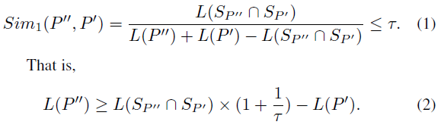

Tech. 2: Diversified path lower bound
If a candidate path (still waiting for expending) is highly similar to a path in the result set, this candidate path may be pruned.
For example, , we have:
For any complete path which begins with partial path P to be inserted into Ψ, its length is not smaller than LB2(P)

Slide 16
Tech. 2: Diversified path lower bound
10
B
1
C
A
1
1
10
D
Example
Assume result set Ψ={P1, P2}.
Now, processing P3, P3=A->B->H->E
3
F
18
P1
20
1
1
I
H
E
1
15
10
B
1
C
A
1
1
10
P2
18
D
Let tau=0.5, we now check whether to expend P3 or not.
20
3
F
I
1
1
H
E
1
15
For P1:
10
B
1
C
For P2:
A
1
1
10
18
D
P3
20
3
F
I
1
1
Thus, only when L(P3)>54, (max(9, 54)), P3 can be in the result set.
H
E
1
15

Slide 17
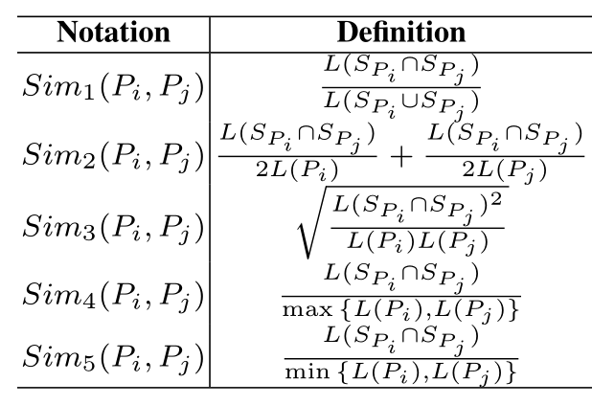





Tech. 2: Diversified path lower bound
For other similarity functions:

Slide 18
The final algorithm
For each path, its lower bound lb is decided by the greater one of the shortest path lower bound LB1 and the diversified path lower bound LB2.
All partial paths are sorted by their lower bounds lb in an ascending order
After a shortest path is found, the corresponding pruned partial paths are needed to be reconsidered, because they can be the next shortest path

Slide 19
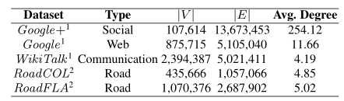
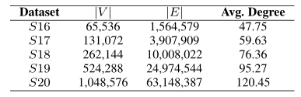
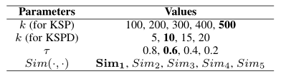
Evaluation
Dataset:
Parameters:

Slide 20
Evaluation
Methods
IterBound is the state-of-the-art method for solving KSP problem
div-cut is an exact algorithm for finding the top-k diversified results
FindKSPD is the final algorithm we propose to find the approximate KSPD
FindKSP is the KSP version of our final algorithm FindKSPD by setting τ=1. That is the case that the diversified path lower bounds are disabled.
FindKSPD- is the simplified version of FindKSPD that only uses the shortest path lower bound.

Slide 21
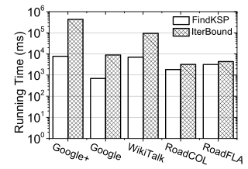
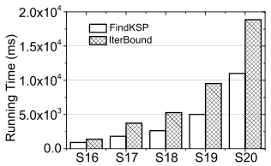
Efficiency of shortest path lower bound

Slide 22
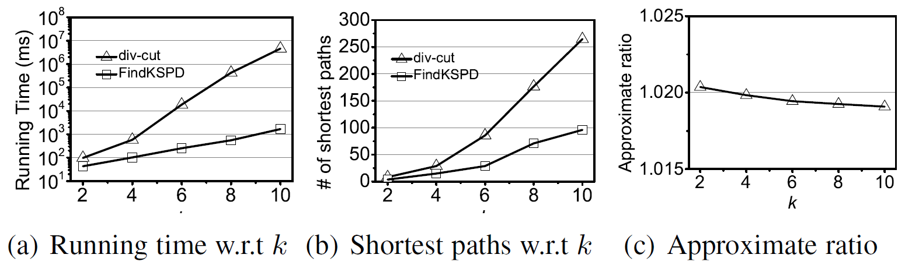
Efficiency of diversified path lower bound
the exact algorithm div-cut is really slow for KSPD problem
the approximate results returned by FindKSPD are very close to the optimal results

Slide 23
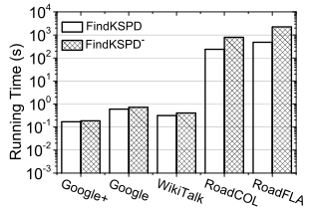
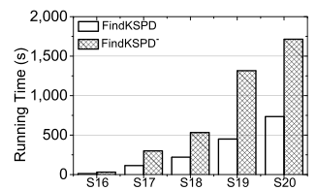
Efficiency of diversified path lower bound

Slide 24
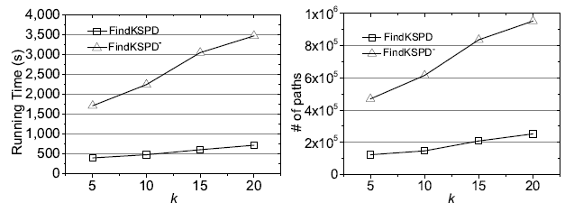
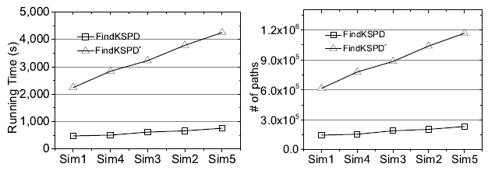
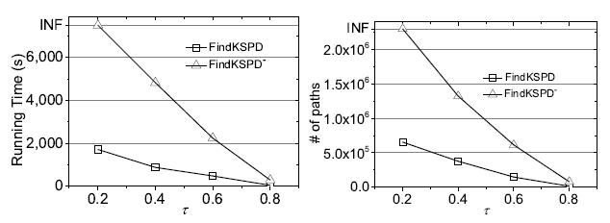
Efficiency of diversified path lower bound

Slide 25
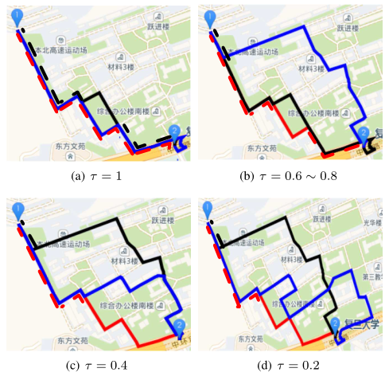
Case study

Slide 26
Conclusion
We study the top-k shortest simple paths with diversity (KSPD) by considering the diversity of paths
We propose a general greedy framework for KSPD problem, which supports different similarity functions and also KSP problem when diversity is not required
We utilize two lower bounds to improve the efficiency by filtering unnecessary paths

